Slide 1
19.2 Multiple Alleles
In a population, there may be more than two alleles for a given trait
If a gene exists in more than two alleles, it is said to have multiple alleles

Slide 2
Coat colour in rabbits
E.g. Coat colour in rabbit controlled by 3 alleles
  C the allele for full colour (grey)
  c^{h} the allele for Himalayan (white coat, pink eyes, black/brown feet, ears, tail, tip of nose)
  cª the allele for albino white
Through breeding experiments ➔ allele for full colour is dominant over the other alleles ➔ Himalayan is dominant over albino

Slide 3
Genotype of the various coat colours are shown below:
Several other alleles for coat colour have been found.
These alleles are recessive to the full colour but together with other alleles will show intermediate coat colour
Phenotype | Genotype
Full colour | CC, Cc^{h}, Ccª
Himalayan | c^{h}c^{h}, c^{h}cª
Albino | cªcª

Slide 4
Human Blood Groups
E.g. Blood groups in Man
4 blood groups in human population ➔ A, B, AB and O blood groups
Allele for A group ➔ I^{A}
Allele for B group ➔ I^{B}
Allele for O group ➔ I^{O}
I^{A} and I^{B} are dominant over I^{O}
I^{A} and I^{B} are co-dominant ➔ people with alleles
I^{A} and I^{B} will have AB blood group

Slide 5
The blood groupings and their respective genotypes are shown:
Blood group | Genotype
A | I^{A} I^{A} or I^{A} I^{O}
B | I^{B} I^{B} or I^{B} I^{O}
AB | I^{A} I^{B}
O | I^{O} I^{O}
The genotype I^{O} I^{O} is a homozygous recessive

Slide 6
Worked Example 3
Textbook Page 367

Slide 7
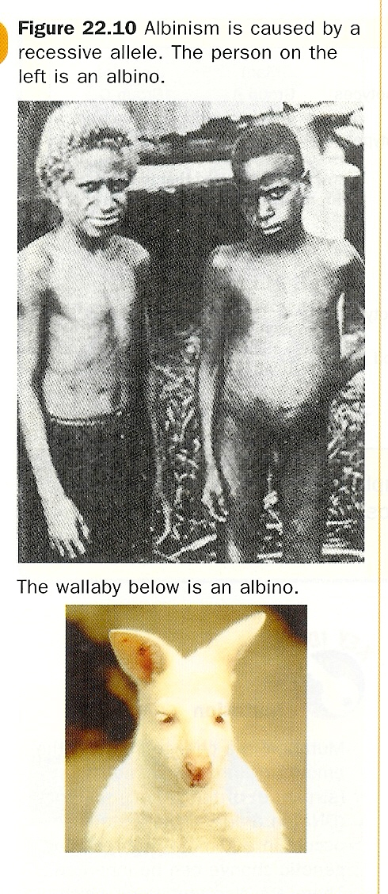
Mutations
Mutation is the sudden or spontaneous change in gene structure of a chromosome, or even the chromosome number, and may be inheritable
Some examples of mutations
  Albinism
  Sickle-cell anaemia
  Down’s syndrome

Slide 8
Sickle-cell anaemia
Results in slight chemical structural change in the genetic material (DNA)
Mutated gene is recessive and so expresses itself only in the homozygous recessive condition
  Have abnormal haemoglobin in their red blood cells
  Red blood cells become sickle shaped
  Unable to transport oxygen efficiently
  Severe anaemia is fatal, leading to death when young

Slide 9
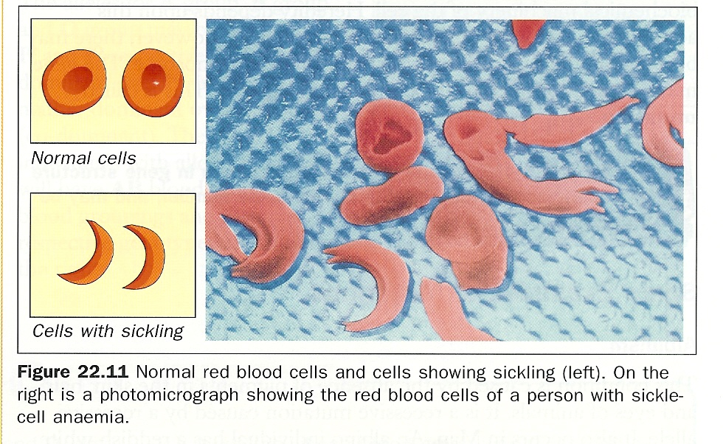

Slide 10
In normal circumstances, such a harmful allele would have been eliminated from a population as the affected individual would die before reproducing
This disease common in West Africa where malaria is prevalent. Why?
  Heterozygous individuals (Ss) more resistant to malaria than individuals who have two copies of the normal haemoglobin allele. Hence the heterozygous individual has a better chance in surviving and reproducing than normal individuals

Slide 11
Chromosome mutation
Extra chromosome in the 21st pair of chromosome
Such people have 47 chromosomes in their body ➔ Down’s syndrome
Normally, zygotes with extra chromosomes fail to develop. One of the exceptions is a zygote with an extra chromosome 21.

Slide 12
Mutagenic Agents
Rate of spontaneous mutation is very low
This rate can be increased greatly by the presence of certain agents known as mutagens
E.g. ultraviolet light, alpha, beta and gamma radiations, some chemicals (chloroform, organic solvents etc)

Slide 13
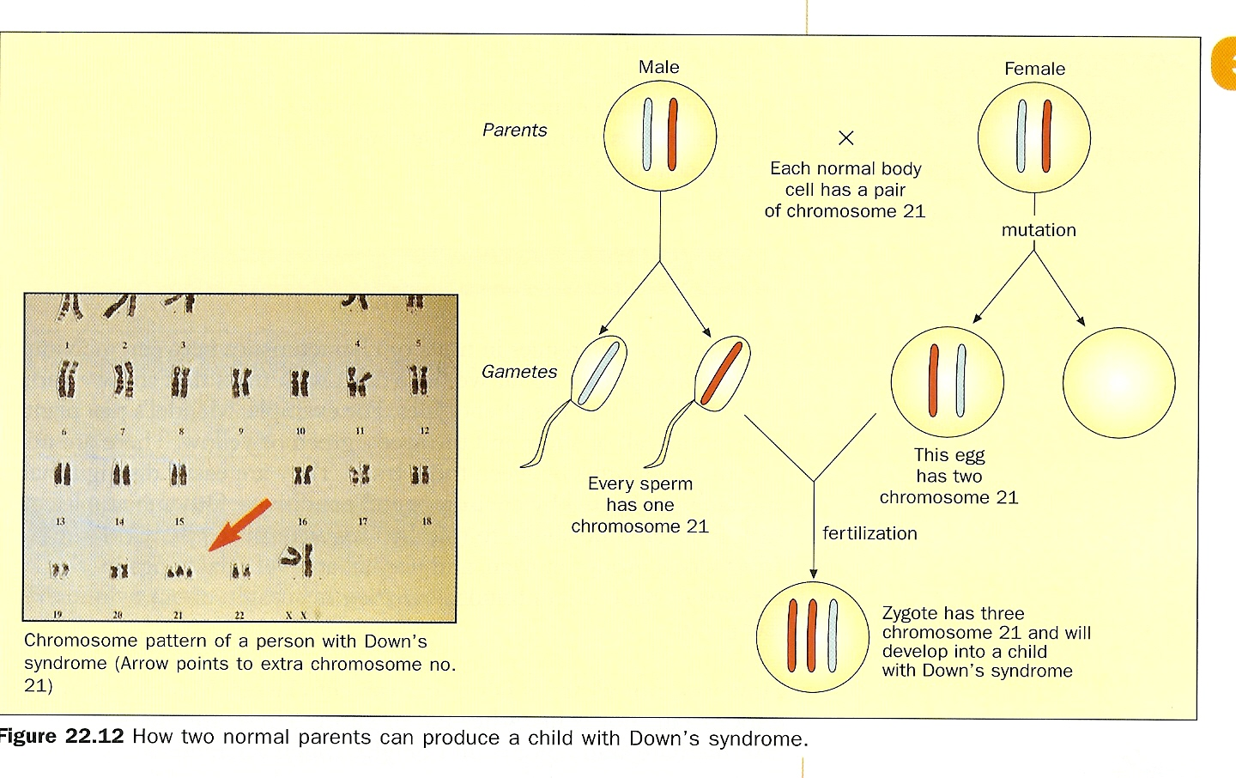

Slide 14
Discontinuous vs Continuous variation
Variations are differences in traits or characteristics between individuals
Continuous variation is where there is a complete range of measurements from one extreme to another (individuals do not fall into distinct categories)
A continuous variation is brought about by the combined (or additive) effect of many genes
Discontinuous variation is where individuals fall into distinct categories

Slide 15
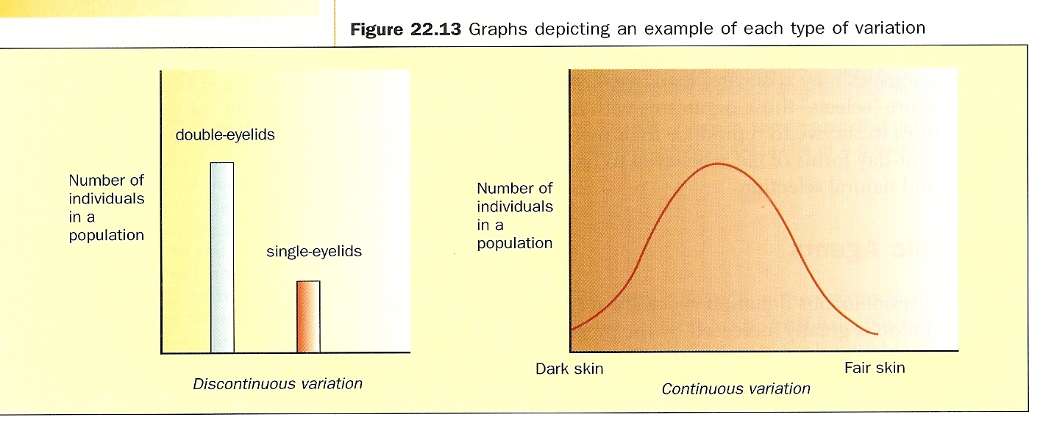

Slide 16
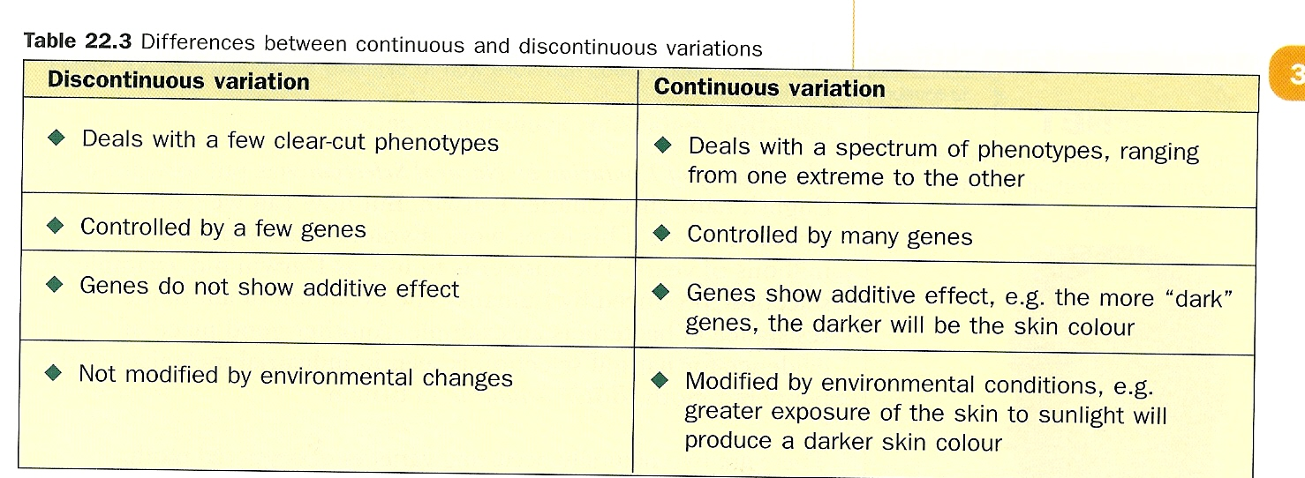
e.g. ability to roll tongue, blood groups in man
e.g. skin colour, height, weight

Slide 17
TYS (4.2B)
All MCQ
Paper 2 Section A
Q 2 and 4 and 5

Slide 18
Natural Selection
A process which results in the best adapted organisms in a population surviving to reproduce and so pass on more of their genes to the next generation
Mutation provides new genes or alleles, and hence variation, for natural selection to operate on.
New breed of organisms may change so much that they become new species ➔ evolution

Slide 19
Fig. 19.20

Slide 20
Artificial Selection
Selection is a method used to produce plants and animals with desirable traits
  E.g. Selecting plants that produce seeds with high oil content in soybean
  Cultivated sugar cane resistant to disease and also rich in sugar
  Cows that produce more milk and can thrive in warm climate
Read pg 374 and 379 for more details

Slide 21
Artificial Selection | Natural Selection
Man selects the varieties of organisms that suit his needs | Selection occurs when natural environmental conditions change
Varieties are produced by selective breeding | Varieties are produced by mutations

Slide 22
TYS (4.2A)
All MCQ
Paper 2 (Section A)

Slide 23
Genetic Engineering
Nature of genes
Genes inherited from our parents found in chromatin threads (chromosomes) in the nucleus
23 from mother, 23 from father
Each chromatin thread is made up of DNA wrapped around proteins
The 2 DNA strands form a double helix

Slide 24
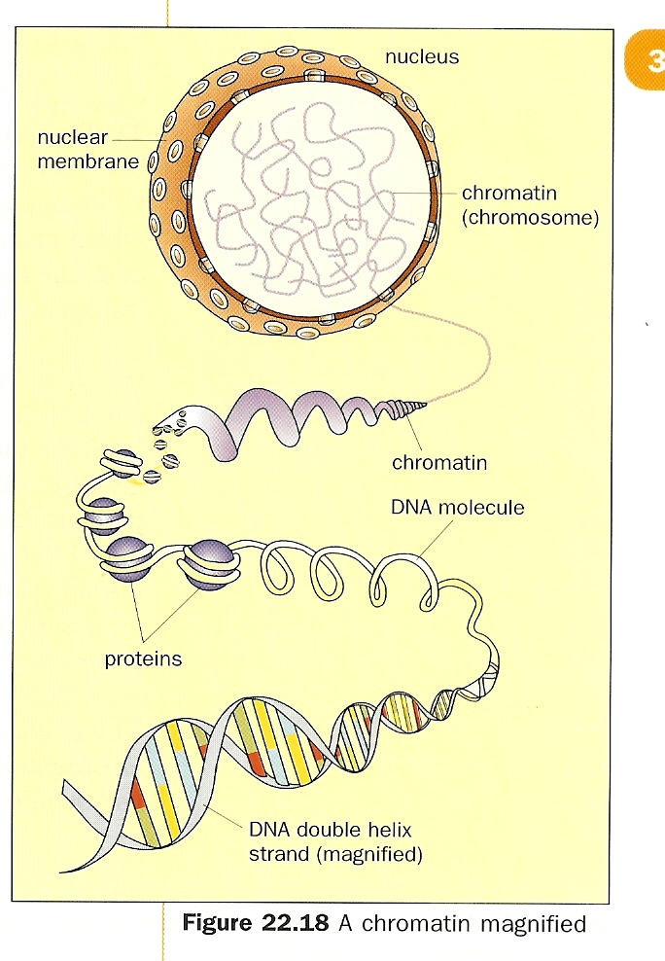

Slide 25
Gene
A small fragment of DNA which controls the formation of a single protein or enzyme
There are many genes along the DNA strand.
Each gene stores a message (genetic code) which determines how an enzyme or protein should be made in the cell
Each protein or enzyme contributes to the development of a certain characteristics in our bodies

Slide 26
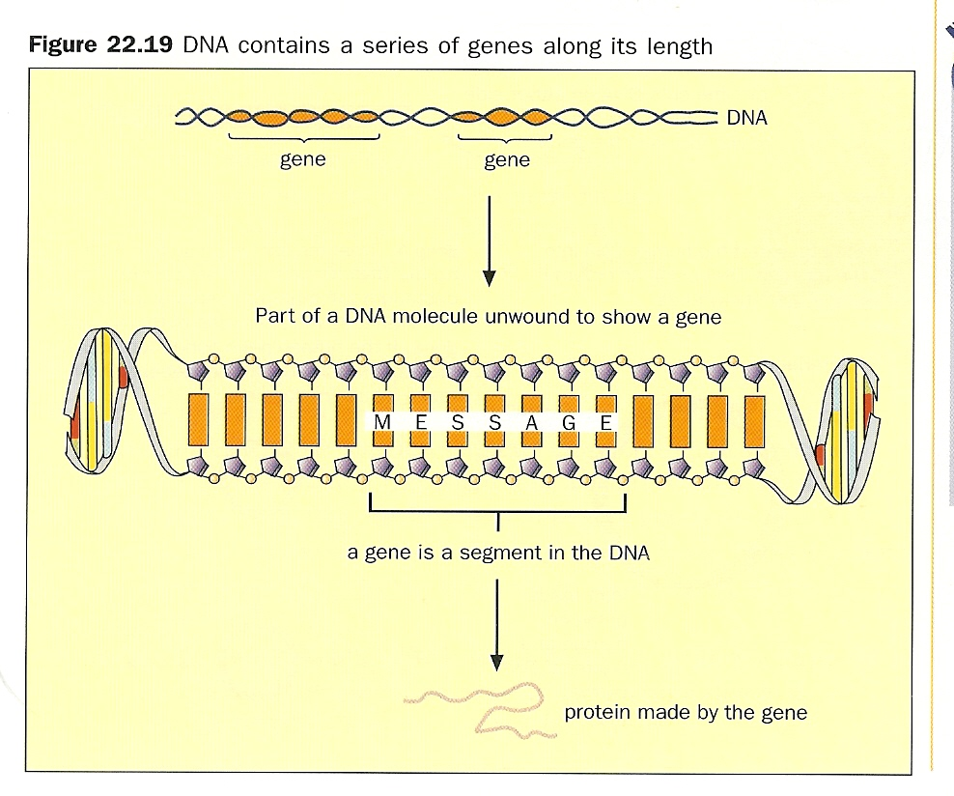

Slide 27
Genes
If genetic code is altered, it may affect our body structure or function
E.g. Sickle cell anemia
  The genetic code for one amino acid in the haemoglobin protein was changed slightly, resulting in a code that produced in another amino acid in its place.
In many cases, more than one type of polypeptide chain is involved in the formation of a protein molecule. E.g. insulin

Slide 28
Genes
Many genes are switched off, except when needed in the relevant cells in the body
For example, the genes for insulin production only express themselves in special cells in the pancreas
Oncogenes (cancer genes) may be activated in our cells and cause cancer later in our lives

Slide 29
Transfer of Genes from One Organism to Another
Genetic engineering is a technique used to transfer genes from one organism to another
Certain genes may be cut off from the cells of one organism and inserted into cells of another organism of the SAME or DIFFERENT species
A vector (plasmid) is used to transfer the gene
The transferred gene can express itself in the genetically engineered organism

Slide 30
Transgenic bacteria and the production of insulin
Gene (from human) for making insulin transferred to bacterial cell
Gene causes bacteria to produce insulin
Any organism which acquires a foreign gene is called a transgenic organism
In this case, the bacterium which has the insulin gene is a transgenic bacterium

Slide 31
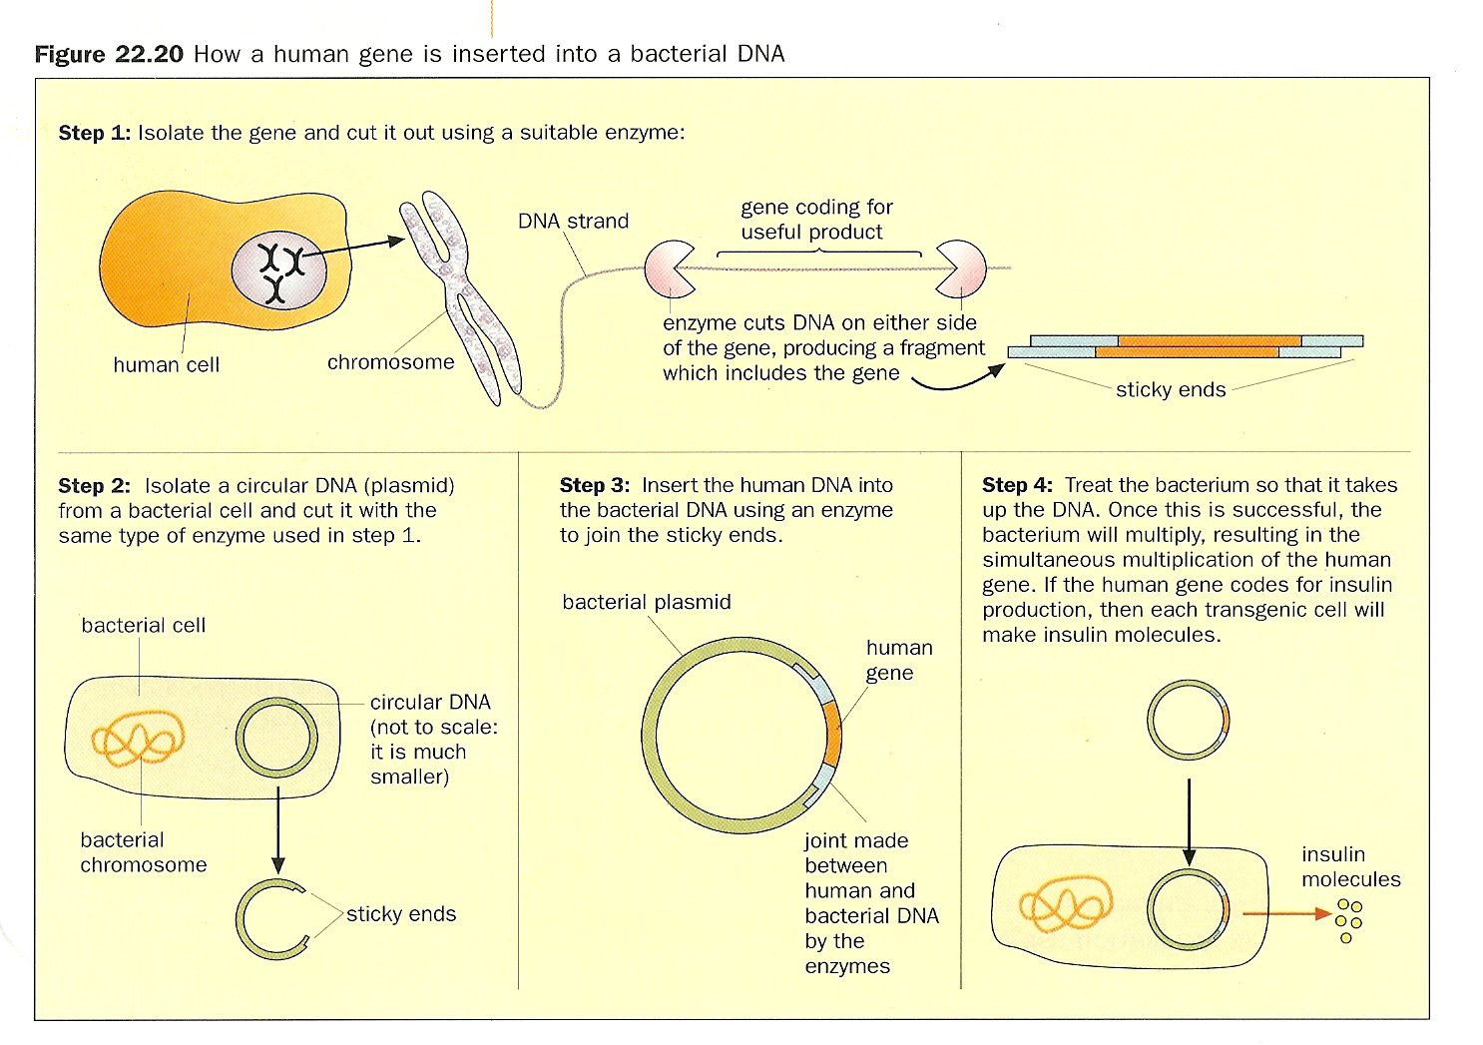

Slide 32
Advantages
New insulin produced by genetic engineering is exactly the same as human insulin. Hence, no danger or rejection by people who use the insulin to control their sugar level
Also, the genetically engineered bacteria multiply rapidly to form a large population which makes large quantities of the gene product (e.g. insulin)
Large scale production of insulin with the use of fermenters is done. Insulin is then extracted and purified

Slide 33
Advantages of G.E.
Can insert a gene from any organism into a plant or an animal
No transmission of defective genes unlike selective breeding
G.E. experiments with individual cells, which can reproduce rapidly in the lab in a small container
Increases productivity and efficiency in the breeding of organisms. This increases profitability (e.g. transgenic salmon grows faster and requires less food)

Slide 34
Risks of G.E.
Allergy to transgenic food which people eat
Genes that code for an antibiotic resistance accidentally incorporated into bacteria that cause diseases to humans
Some people may deliberately create combination or genes which they may use in chemical or biological warfare

Slide 35
4.2B
MCQ
73, 74, 75, 76, 78, 81, 85, 87, 88, 89, 91, 94, 95, 96, 99, 100
Section A
12, 25

Slide 36
Topic 4.2A
MCQ
Q20 – 32
Section A
Q2

Slide 37
Topic 4.2B
MCQ
Q54 – 69
Section A
19, 21, 23

