Slide 1
1. Match the stages of mitosis with their descriptions.
Stages of mitosis | Description
(a) Anaphase | (i) Chromosome shorten and thicken
(b) Telophase | (ii) Chromosomes are arranged at the equator
(c) Metaphase | (iii) Two daughter cells are produced
(d) Prophase | (iv) Chromatids move to different poles

Slide 2
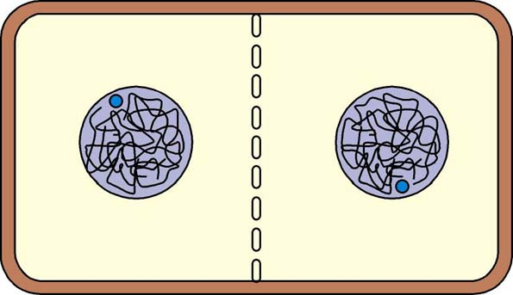
Mitosis in Plant Cells:
similar to animal cells except:
centrioles are absent
cleavage / furrow do not occur during cytokinesis.
Instead, a cell plate divides the 2 daughter nuclei.
Cell plate (by fusion of vesicles)

Slide 3
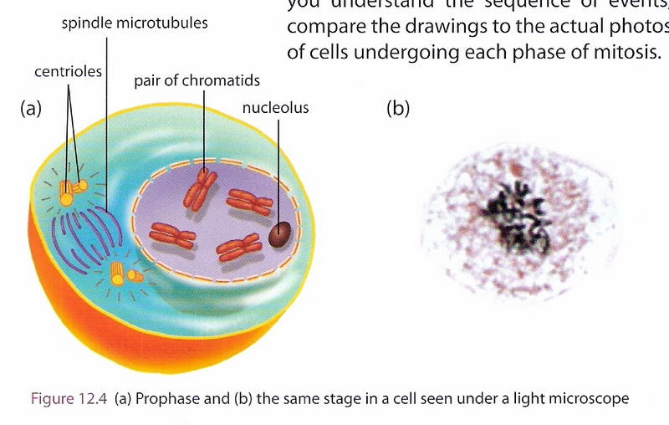

Slide 4
Importance of Mitosis
Mitosis is important:
for growth
for organism to grow, new cells must be produced by mitosis
for repair of worn out parts
dead cheek cells are replaced by new cells produced by mitosis
skin produces new cells to heal wounds
in asexual reproduction
mitosis causes shoots and roots to develop in rhizomes / bulbs

Slide 5
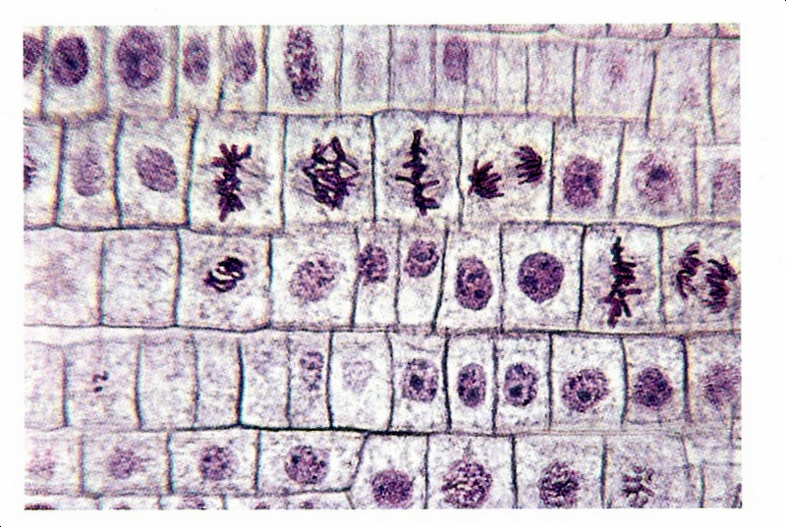

Slide 6
Workbook Pg 143
MCQ
Q1, 2, 3, 4
Structured Questions
Q2, 3, 4

Slide 7
Test Yourself! (page 343)
1 Root tip or shoot tip. The cells are in various stages of mitotic division
and the root and shoot tip are the only growing points in a mature plant.
2 (a) During interphase, just before mitosis.
(b) Interphase
3
Mitosis is important:
for growth
For organism to grow, new cells must be produced by mitosis.
for repair of worn out parts
eg Dead cheek cells are replaced by new cells produced by mitosis
Skin produces new cells to heal wounds.
in asexual reproduction
Mitosis causes shoots and roots to develop in rhizomes / bulbs

Slide 8
18.3 Meiosis

Slide 9
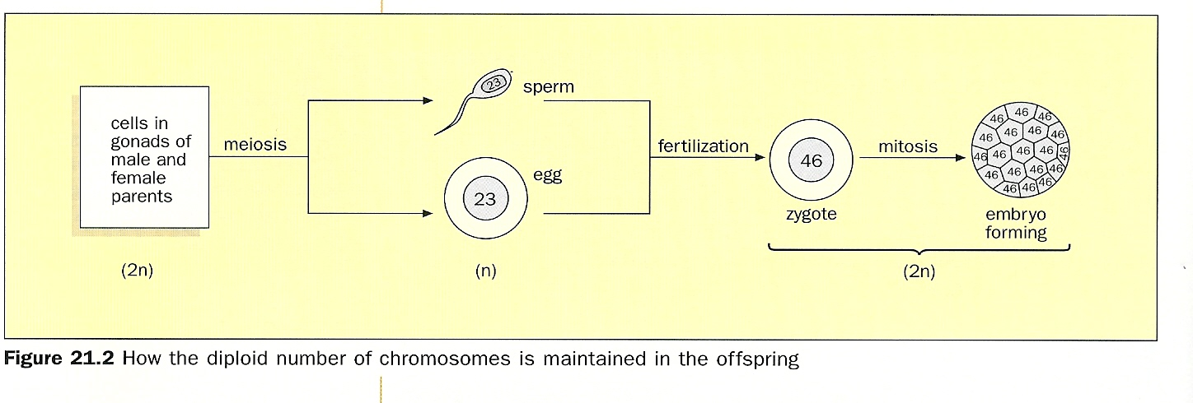
Why are gametes haploid?
Zygote is formed by fusion of 2 gametes.
Each gamete must only have half the number of
chromosomes as the zygote.
Gametes are haploid (n) so that during fertilisation,
when a sperm (n) fuses with an egg (n),
a zygote which is diploid (2n) is formed. This maintains
the diploid number of chromosomes in the offspring.

Slide 10
Gametes Vs Body Cells
Body cells = 46 chromosomes ( 23 chromosomes from sperm, 23 from egg)
= 23 pairs
= diploid number (2n)
= full number of chromosomes
Gametes = 23 chromosomes
= haploid number (n) i.e.
= half the number of chromosomes found
in the body cells.
A Gamete is a reproductive cell with
haploid number of chromosomes.

Slide 11
Meiosis
What is Meiosis?
Meiosis
is a nuclear division such that the daughter nuclei produced contain half the number of chromosomes as the parent nucleus.
produces cells with haploid (n) number of chromosomes. (Reduction Division).
consists of two divisions: meiosis I and meiosis II.
Each division consists of: prophase, metaphase, anaphase and telophase.
Copyright © 2006-2011 Marshall Cavendish International (Singapore) Pte. Ltd.
January 16, 10
11
Notes:
Figure 18.20 page 345

Slide 12
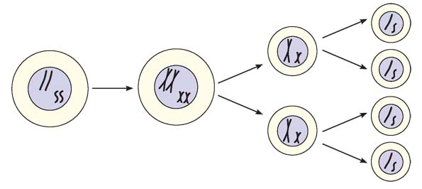
Overview of Meiosis
Meiosis I Meiosis II
1 Parent cell Replication Each daughter cell 4 haploid gametes
2n = 4 of DNA has 2 chromosomes n =2
with 2 chromatid

Slide 13
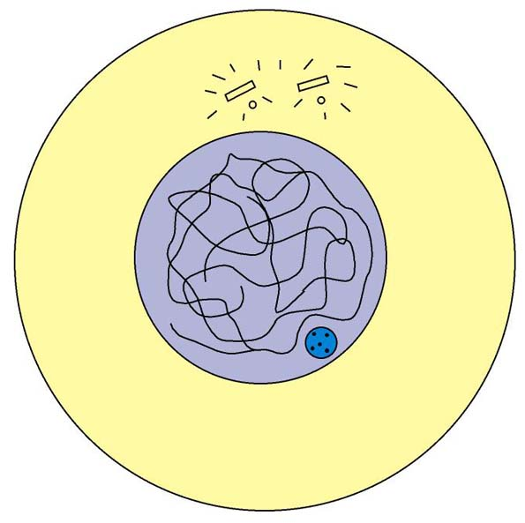
Meiosis
centrioles
nuclear envelope
asters
Interphase
Chromatin threads
replicate, producing two identical sister chromatids attached at the centromere.
are not visible under microscope.
Centrioles
divide (animal cell).
chromatin threads
nucleolus
cytoplasm
cell surface membrane
Copyright © 2006-2011 Marshall Cavendish International (Singapore) Pte. Ltd.
January 16, 10
13
Notes:
Figure 18.20 page 345

Slide 14
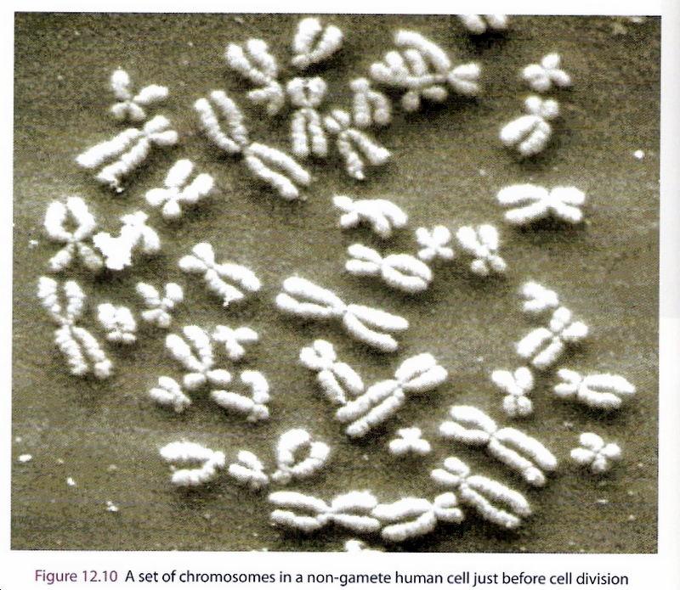

Slide 15
Meiosis I
Copyright © 2006-2011 Marshall Cavendish International (Singapore) Pte. Ltd.
January 16, 10
15

Slide 16
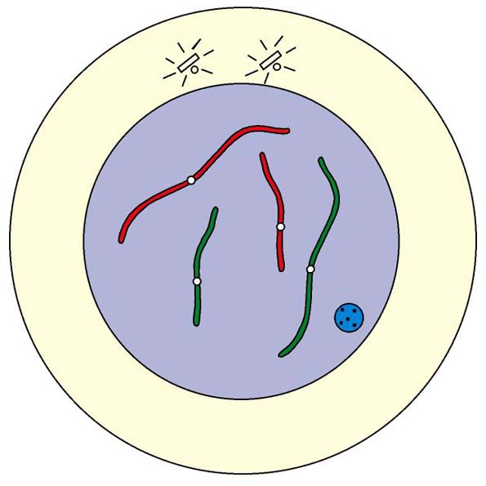
Meiosis
centriole
1
Prophase I
Chromatin threads
condense, coil and shorten to become chromosomes.
nuclear envelope
aster
chromosome
nucleolus
centromere
cytoplasm
Copyright © 2006-2011 Marshall Cavendish International (Singapore) Pte. Ltd.
January 16, 10
16
Notes:
Figure 18.21a page 346

Slide 17
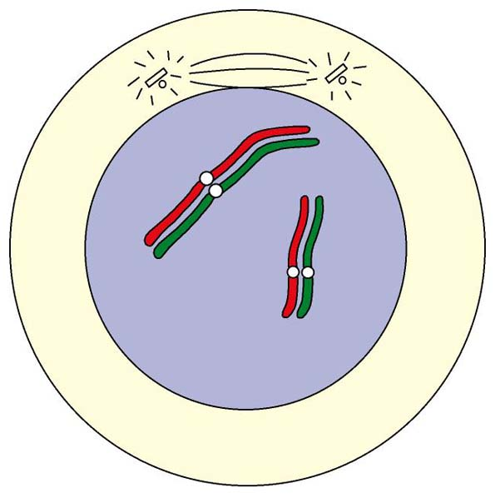
Meiosis
aster
1
Prophase I
Homologous chromosomes
pair (synapsis).
have the same shape, same genes and same length.
one homologous chromosome comes from father, the other from mother.
Asters
appear around the centrioles which move apart to opposite poles of the cell.
spindle fibre
centriole
chromosome from mother
a pair of homologous chromosomes
chromosome from father
Copyright © 2006-2011 Marshall Cavendish International (Singapore) Pte. Ltd.
January 16, 10
17
Notes:
Figure 18.21b page 346

Slide 18
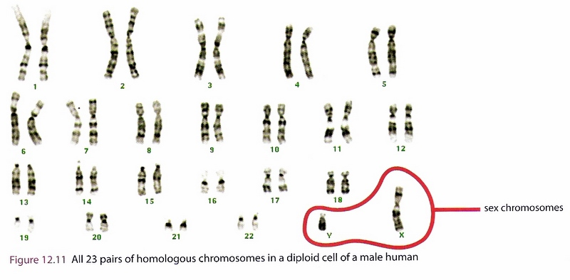

Slide 19
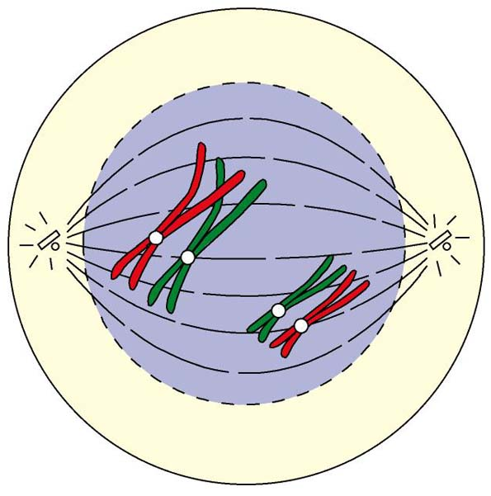
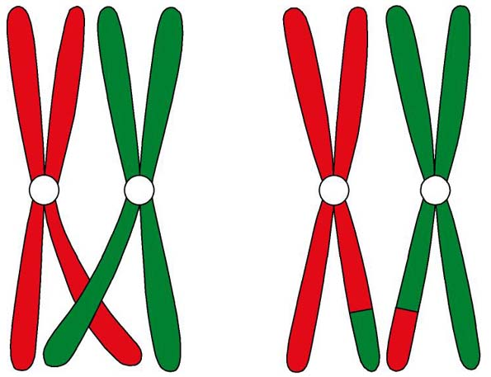
Meiosis
nuclear envelope disintegrates
Prophase I
Chromosomes shorten; each chromosome consists of two chromatids attached at the centromere.
Chromatids of homologous chromosomes may cross and twist around each other. (point = chiasma (plural: chiasmata).
Coiling cause them to break and exchange parts ( process = crossing over. Crossing over produces new combinations of genes along the chromosomes.
The centrioles reach opposite poles of the cell. The nuclear envelope and nucleolus disappear. Spindle fibres form.
spindle fibre
1
centriole
aster
chromatids
centromere
chiasma
Copyright © 2006-2011 Marshall Cavendish International (Singapore) Pte. Ltd.
January 16, 10
19
Notes:
Figure 18.21a & b page 346

Slide 20
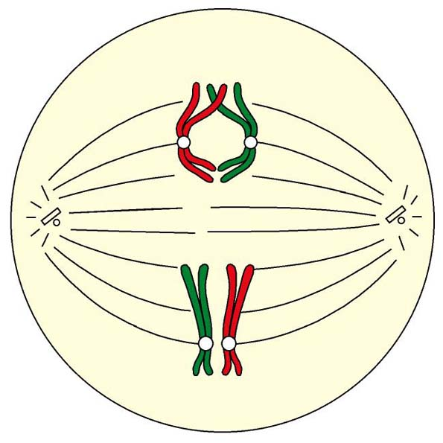
Meiosis
equator
2
Metaphase I
Pairs of homologous chromosomes arrange themselves along the equator of the cell.
The two chromosomes of each pair face opposite poles of the cell.
homologous chromosomes face opposite poles
Copyright © 2006-2011 Marshall Cavendish International (Singapore) Pte. Ltd.
January 16, 10
20
Notes:
Figure 18.22 page 347

Slide 21
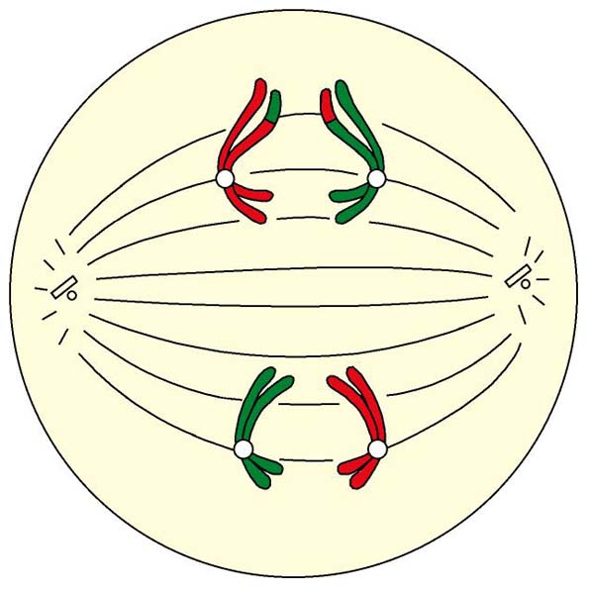
Meiosis
homologous chromosomes moving apart
3
Anaphase I
Homologous chromosomes separate and move to opposite poles of the cell.
Each chromosome here is still made up of two chromatids.
equator
sister chromatids (one chromosome)
Copyright © 2006-2011 Marshall Cavendish International (Singapore) Pte. Ltd.
January 16, 10
21
Notes:
Figure 18.23 page 347

Slide 22
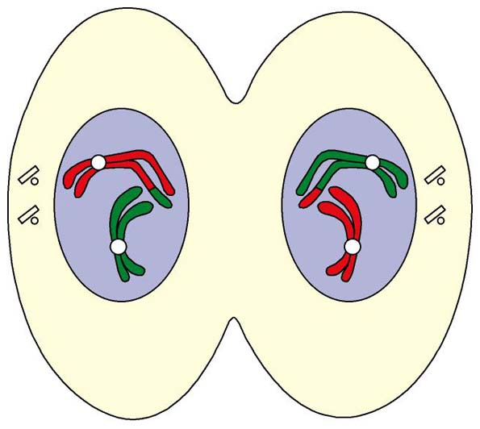
Meiosis
one pair of centrioles
4
Telophase I
A nuclear membrane forms around the chromosomes at each pole.
This is followed by division of the cytoplasm. The cytoplasm cleaves into two, producing two daughter cells, each with the haploid number of chromosomes.
The centrioles replicate.
chromosomes
cytoplasm
nuclear membrane / nuclear envelope
Copyright © 2006-2011 Marshall Cavendish International (Singapore) Pte. Ltd.
January 16, 10
22
Notes:
Figure 18.24 page 347

Slide 23
Meiosis II
Copyright © 2006-2011 Marshall Cavendish International (Singapore) Pte. Ltd.
January 16, 10
23

Slide 24
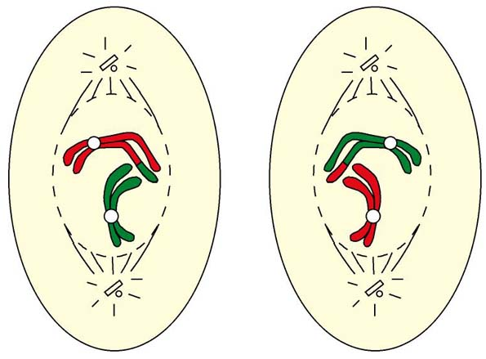
Meiosis
centrioles
1
Prophase II
The centrioles move to opposite poles.
Nuclear envelope breaks down.
Spindle fibres appear.
nuclear envelope breaks down
spindle fibres
Copyright © 2006-2011 Marshall Cavendish International (Singapore) Pte. Ltd.
January 16, 10
24
Notes:
Figure 18.25 page 348

Slide 25
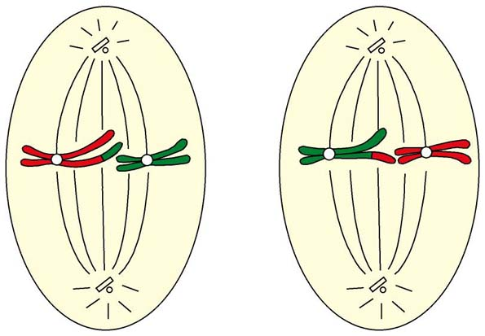
Meiosis
2
equator
Metaphase II
Chromosomes arrange themselves along the equator of the spindle.
chromosomes
spindle fibres
Copyright © 2006-2011 Marshall Cavendish International (Singapore) Pte. Ltd.
January 16, 10
25
Notes:
Figure 18.25 page 348

Slide 26
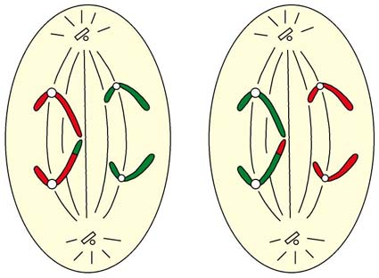
Meiosis
centromere
3
Anaphase II
The centromeres divide.
Sister chromatids separate and are pulled towards opposite poles of the cell.
sister chromatids
spindle fibres
Copyright © 2006-2011 Marshall Cavendish International (Singapore) Pte. Ltd.
January 16, 10
26
Notes:
Figure 18.25 page 348

Slide 27
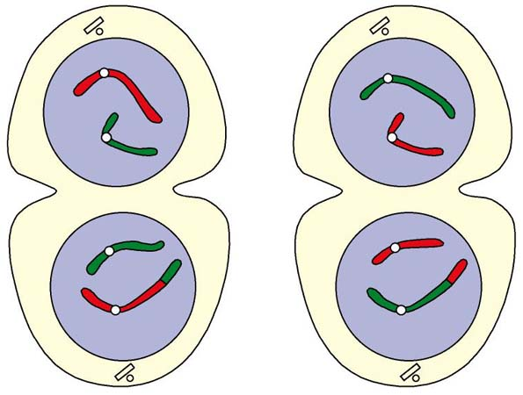
Meiosis
chromosomes
nuclear envelope
4
Telophase II
Spindle fibres disappear.
Nuclear envelopes form around the daughter chromosomes at each pole.
Cleavage of cytoplasm results in four daughter cells, each with half the number of chromosomes as the parent cell.
furrow
cytoplasm
Copyright © 2006-2011 Marshall Cavendish International (Singapore) Pte. Ltd.
January 16, 10
27
Notes:
Figure 18.25 page 348

Slide 28
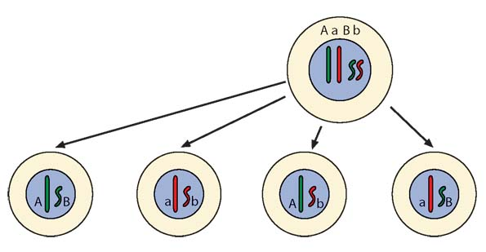
Importance of Meiosis
Meiosis
produces haploid gametes.
When male gamete fuses with female gamete, the diploid
number of chromosomes is restored in zygote.
results in variations in the gametes produced.
Variations occur due to:
crossing over and
independent assortment of chromosomes.

Slide 29
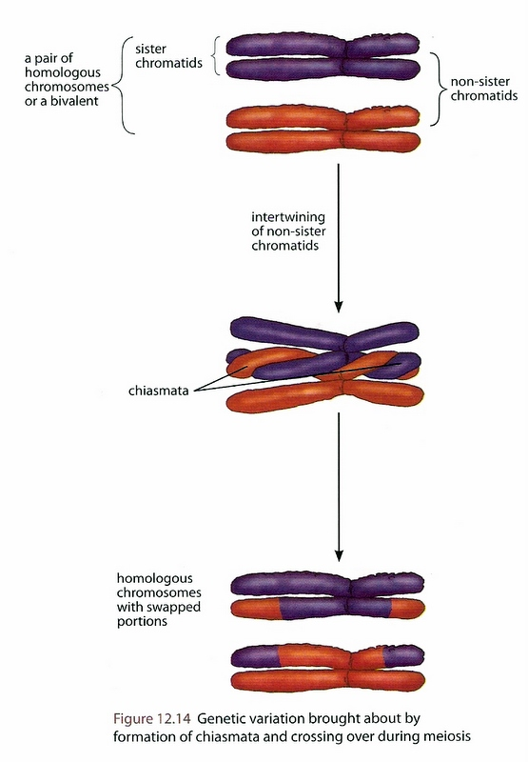
Variation
is brought about
during meiosis by:
1. crossing over
2. independent assortment
1. Crossing-over

Slide 30
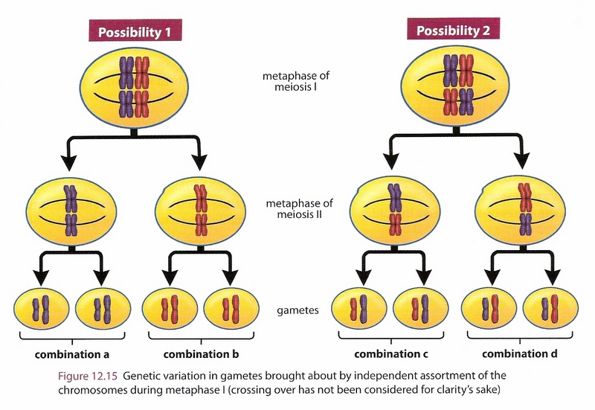
2. Independent Assortment

Slide 31
Importance of Meiosis
Since fertilisation is random i.e.
any sperm can fuses with any ovum,
such variations in the gametes can produce variations
in the offspring.
Variations increase the chances of survival of
the species during changes in environment.
When environment changes, nature will ’select’ organisms
with favourable characteristics to survive, while others die.
Those that survive pass on the favourable genes to their offspring.
Species live on.

Slide 32
Mitosis vs Meiosis
 | Mitosis | Meiosis
Number of chromosomes | Daughter cells contain same no. of c’somes as parent cell. | Daughter cells contain half the no. of c’somes as parent cell.
Pairing of homologous chromosomes | Does not occur | Occurs at prophase 1
Crossing over | no | May occur
variations | Daughter cells identical to parent cell | Variations in daughter cells.
No of daughter cells produced from one parent cell | Two | four
Nuclear division | one | two
Where process occurs? | In body cells during growth and repair of tissues | In gonads during gamete formation

