Slide 1
Stamens and Pistil of Clitoria
Pistil
The pistil consists of a single carpel.
Section of the carpel of Clitoria
Stigma
The stigma is small and compact. It is located at the end of the style.
Copyright © 2006-2011 Marshall Cavendish International (Singapore) Pte. Ltd.
January 16, 10
1
Notes:
Figure 16.14 Page 304

Slide 2
Stamens and Pistil of Clitoria
Pistil
The pistil consists of a single carpel.
Section of the carpel of Clitoria
Stigma
The stigma is small and compact. It is located at the end of the style.
Style
The style is a long, curved, hairy structure.
Copyright © 2006-2011 Marshall Cavendish International (Singapore) Pte. Ltd.
January 16, 10
2
Notes:
Figure 16.14 Page 304

Slide 3
Stamens and Pistil of Clitoria
Pistil
The pistil consists of a single carpel.
Section of the carpel of Clitoria
ovule
Ovary
The ovary is long and narrow with a single row of ovules.
Stigma
The stigma is small and compact. It is located at the end of the style.
Style
The style is a long, curved, hairy structure.
Copyright © 2006-2011 Marshall Cavendish International (Singapore) Pte. Ltd.
January 16, 10
3
Notes:
Figure 16.14 Page 304

Slide 5
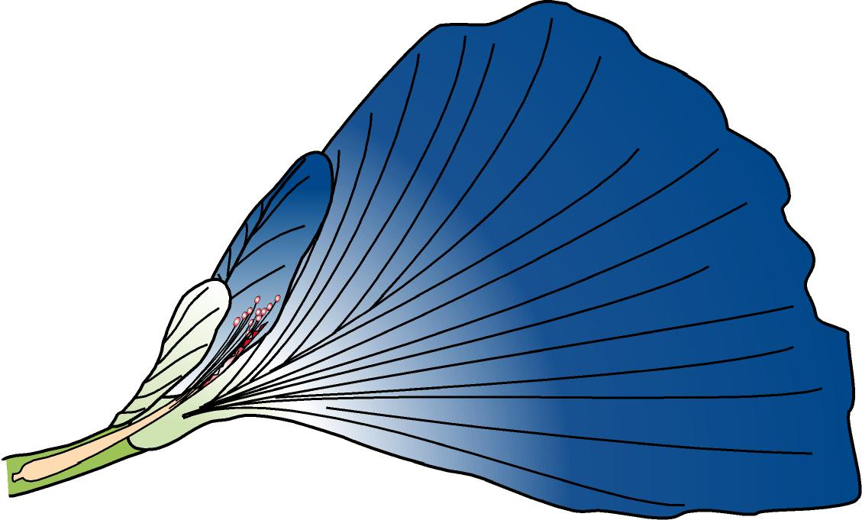
Pollination in an Insect-pollinated Flower (Clitoria)
wing petal
standard petal
keel petal
nectar guide
stigma
stamen trough
stamen
1
In its natural state, the flower is inverted with the standard petal at the bottom.
Copyright © 2006-2011 Marshall Cavendish International (Singapore) Pte. Ltd.
January 16, 10
5
Notes:
Figure 16.15 Page 304

Slide 6
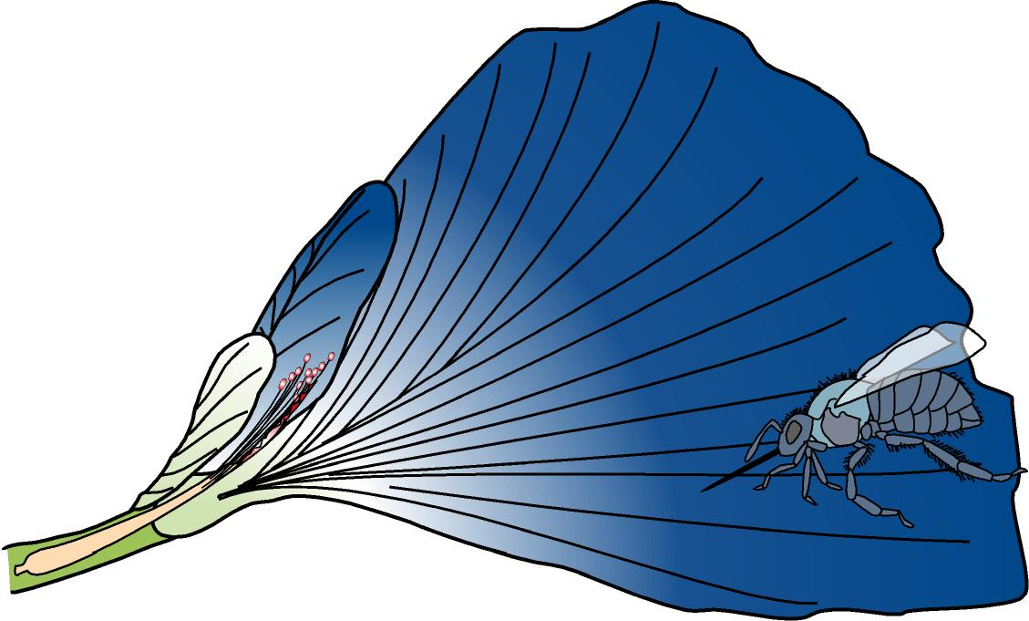
Pollination in an Insect-pollinated Flower (Clitoria)
wing petal
standard petal
keel petal
insect
nectar guide
stigma
stamen trough
stamen
1
In its natural state, the flower is inverted with the standard petal at the bottom.
When a heavy insect such as a bee visits the flower, it lands on the standard petal.
Copyright © 2006-2011 Marshall Cavendish International (Singapore) Pte. Ltd.
January 16, 10
6
Notes:
Figure 16.15 Page 304

Slide 7
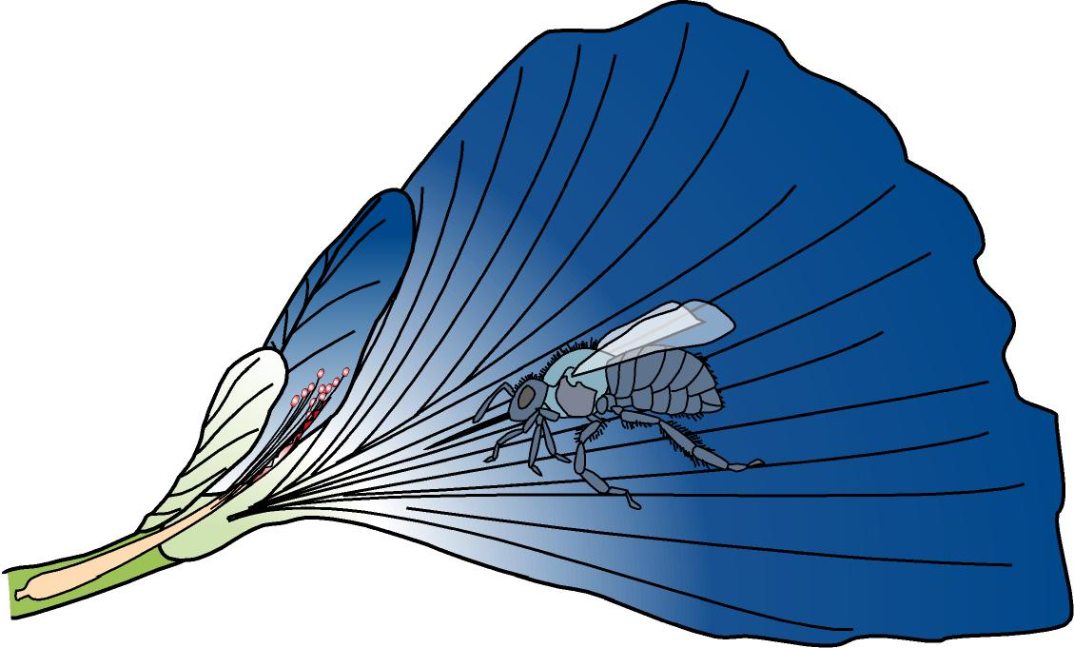
Pollination in an Insect-pollinated Flower (Clitoria)
wing petal
standard petal
keel petal
insect
nectar guide
stigma
stamen trough
stamen
2
The insect follows the nectar guide into the flower.
Copyright © 2006-2011 Marshall Cavendish International (Singapore) Pte. Ltd.
January 16, 10
7
Notes:
Figure 16.15 Page 304

Slide 8
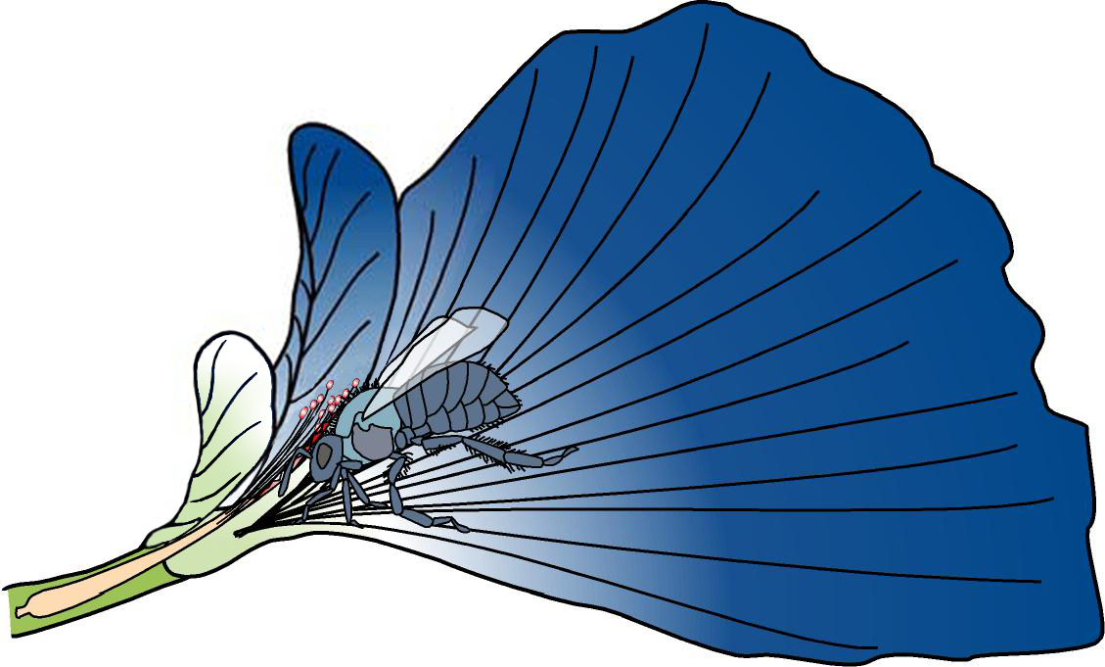
Pollination in an Insect-pollinated Flower (Clitoria)
wing petal
standard petal
keel petal
insect entering flower to collect nectar
nectar guide
stigma
stamen trough
stamen
3
The insect forces its way in between the two wing petals and moves in to collect the nectar.
Copyright © 2006-2011 Marshall Cavendish International (Singapore) Pte. Ltd.
January 16, 10
8
Notes:
Figure 16.15 Page 304

Slide 9
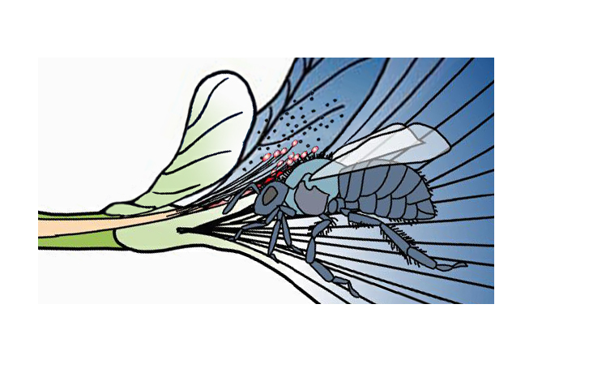
Pollination in an Insect-pollinated Flower (Clitoria)
stamen
insect
wing petal
keel petal
stamen trough
stigma
4
The insect’s back forces the keel petal upwards to expose the stigma and the anthers.
Copyright © 2006-2011 Marshall Cavendish International (Singapore) Pte. Ltd.
January 16, 10
9
Notes:
Figure 16.15 Page 304

Slide 10
Pollination in an Insect-pollinated Flower (Clitoria)
stamen
insect
wing petal
keel petal
stamen trough
stigma
4
The insect’s back forces the keel petal upwards to expose the stigma and the anthers.
The stigma and anthers brush against the hairy back of the insect.
Copyright © 2006-2011 Marshall Cavendish International (Singapore) Pte. Ltd.
January 16, 10
10
Notes:
Figure 16.15 Page 304

Slide 11
Pollination in an Insect-pollinated Flower (Clitoria)
pollen grain
stamen
hair
insect
wing petal
keel petal
stamen trough
stigma
4
The insect’s back forces the keel petal upwards to expose the stigma and the anthers.
The stigma and anthers brush against the hairy back of the insect.
When this happens, some pollen grains from the anther stick to the hairy back of the insect.
Copyright © 2006-2011 Marshall Cavendish International (Singapore) Pte. Ltd.
January 16, 10
11
Notes:
Figure 16.15 Page 304

Slide 12
Pollination in an Insect-pollinated Flower (Clitoria)
pollen grain
stamen
hair
insect
wing petal
keel petal
stamen trough
stigma
4
The insect’s back forces the keel petal upwards to expose the stigma and the anthers.
The stigma and anthers brush against the hairy back of the insect.
When this happens, some pollen grains from the anther stick to the hairy back of the insect.
At the same time, pollen grains on the insect’s back (from another flower which the insect had visited earlier) are transferred to the sticky stigma.
Copyright © 2006-2011 Marshall Cavendish International (Singapore) Pte. Ltd.
January 16, 10
12
Notes:
Figure 16.15 Page 304

Slide 13
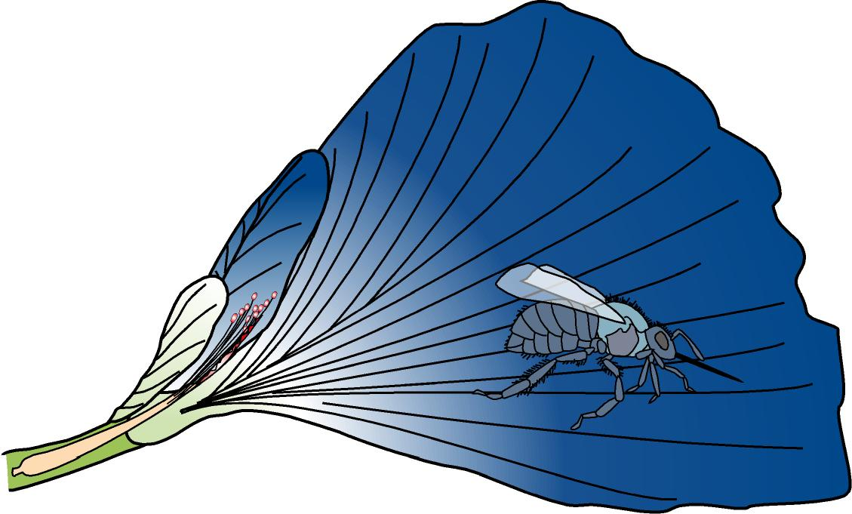
Pollination in an Insect-pollinated Flower (Clitoria)
wing petal
standard petal
keel petal
insect
nectar guide
stigma
stamen trough
stamen
5
When the insect leaves the flower, the keel springs back to its original position to enclose the stamens and the stigma again.
Copyright © 2006-2011 Marshall Cavendish International (Singapore) Pte. Ltd.
January 16, 10
13
Notes:
Figure 16.15 Page 304

Slide 14
The Structure and Pollination of a Wind-Pollinated Flower
Structure of grass flowers (Ischaemum muticum)

Slide 15
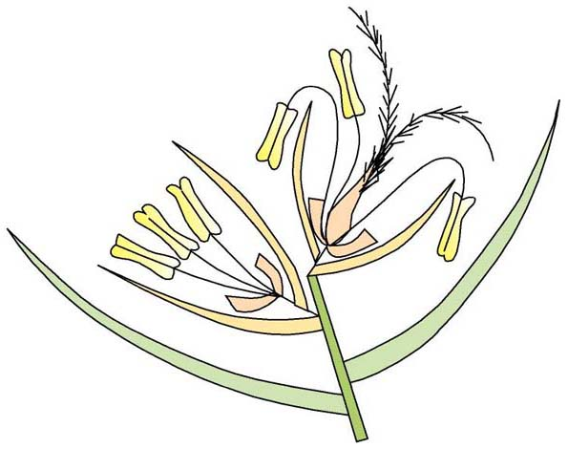
Structure of Ischaemum muticum
pair of flowers
The flowers occur in pairs.
Copyright © 2006-2011 Marshall Cavendish International (Singapore) Pte. Ltd.
January 16, 10
15
Notes:
Figure 16.16 Page 306

Slide 16
Structure of Ischaemum muticum
pair of flowers
flowering bract (scale)
The flowers occur in pairs.
Each Ischaemum flower is enclosed by two transparent flowering bracts.
Copyright © 2006-2011 Marshall Cavendish International (Singapore) Pte. Ltd.
January 16, 10
16
Notes:
Figure 16.16 Page 306

Slide 17
Structure of Ischaemum muticum
pair of flowers
upper bisexual flower
anther
feathery stigmas hanging out of the bracts
filament
lodicule
flowering bract (scale)
The upper flower is bisexual. It consists of an ovary with two long feathery stigmas, three stamens and two tiny structures called lodicules at the base of the ovary.
Copyright © 2006-2011 Marshall Cavendish International (Singapore) Pte. Ltd.
January 16, 10
17
Notes:
Figure 16.16 Page 306

Slide 18
Structure of Ischaemum muticum
pair of flowers
upper bisexual flower
anther
feathery stigmas hanging out of the bracts
filament
lodicule
flowering bract (scale)
The upper flower is bisexual. It consists of an ovary with two long feathery stigmas, three stamens and two tiny structures called lodicules at the base of the ovary.
When Ischaemum is ready to reproduce, the lodicules swell and force the two flowering bracts slightly apart so that the stigmas and anthers can emerge.
Copyright © 2006-2011 Marshall Cavendish International (Singapore) Pte. Ltd.
January 16, 10
18
Notes:
Figure 16.16 Page 306

Slide 19
Structure of Ischaemum muticum
pair of flowers
upper bisexual flower
anther
feathery stigmas hanging out of the bracts
lower male flower
filament
lodicule
flowering bract (scale)
The lower flower is unisexual. It consists of only three stamens with long filaments and two lodicules. Therefore, it is a male flower.
Copyright © 2006-2011 Marshall Cavendish International (Singapore) Pte. Ltd.
January 16, 10
19
Notes:
Figure 16.16 Page 306

Slide 20
Structure of Ischaemum muticum
pair of flowers
upper bisexual flower
anther
feathery stigmas hanging out of the bracts
lower male flower
spikelet
filament
lodicule
flowering bract (scale)
Each pair of flowers, together with a short stalk, forms a spikelet.
Copyright © 2006-2011 Marshall Cavendish International (Singapore) Pte. Ltd.
January 16, 10
20
Notes:
Figure 16.16 Page 306

Slide 21
Structure of Ischaemum muticum
pair of flowers
upper bisexual flower
anther
feathery stigmas hanging out of the bracts
lower male flower
spikelet
filament
non-flowering bract (scale)
lodicule
flowering bract (scale)
Each pair of flowers, together with a short stalk, forms a spikelet.
At the base of each spikelet is a pair of empty or non-flowering bracts. They protect the two flowers in the spikelet.
Copyright © 2006-2011 Marshall Cavendish International (Singapore) Pte. Ltd.
January 16, 10
21
Notes:
Figure 16.16 Page 306

Slide 22
Structure of Ischaemum muticum
pair of flowers
upper bisexual flower
anther
feathery stigmas hanging out of the bracts
lower male flower
spikelet
filament
non-flowering bract (scale)
lodicule
flowering bract (scale)
Spikelets also occur in pairs. The lower spikelet in each pair has no flower stalk, while the upper one is smaller and has a stalk. Both spikelets have similar structures.
Copyright © 2006-2011 Marshall Cavendish International (Singapore) Pte. Ltd.
January 16, 10
22
Notes:
Figure 16.16 Page 306

Slide 23
Structure of Ischaemum muticum
pair of flowers
upper bisexual flower
anther
feathery stigmas hanging out of the bracts
lower male flower
spikelet
filament
non-flowering bract (scale)
lodicule
flowering bract (scale)
Spikelets also occur in pairs. The lower spikelet in each pair has no flower stalk, while the upper one is smaller and has a stalk. Both spikelets have similar structures.
A few pairs of spikelets make up an inflorescence.
Copyright © 2006-2011 Marshall Cavendish International (Singapore) Pte. Ltd.
January 16, 10
23
Notes:
Figure 16.16 Page 306

Slide 24
Pollination in Ischaemum
By wind
Filaments protrude out of the bracts, exposing the anthers
With wind, dust-like pollen grains are shaken free
Stigmas also project out of the bracts. Feathery nature provide a large surface area to receive pollen grain that may be floating around

Slide 25
Pollination in a Wind-pollinated Flower (Ischaemum muticum)
upper bisexual flower
anther
lower male flower
feathery stigmas hanging out of the bracts
filament
lodicule
non-flowering bract (scale)
flowering bract (scale)
The mature stamens have long filaments that hang downwards and can swing freely. We say the filaments are pendulous.
Copyright © 2006-2011 Marshall Cavendish International (Singapore) Pte. Ltd.
January 16, 10
25
Notes:
Figure 16.16 Page 306

Slide 26
Pollination in a Wind-pollinated Flower (Ischaemum muticum)
upper bisexual flower
anther
lower male flower
feathery stigmas hanging out of the bracts
filament
lodicule
non-flowering bract (scale)
flowering bract (scale)
The mature stamens have long filaments that hang downwards and can swing freely. We say the filaments are pendulous.
The filaments hang out of the bracts, exposing the mature anthers to the wind.
Copyright © 2006-2011 Marshall Cavendish International (Singapore) Pte. Ltd.
January 16, 10
26
Notes:
Figure 16.16 Page 306

Slide 27
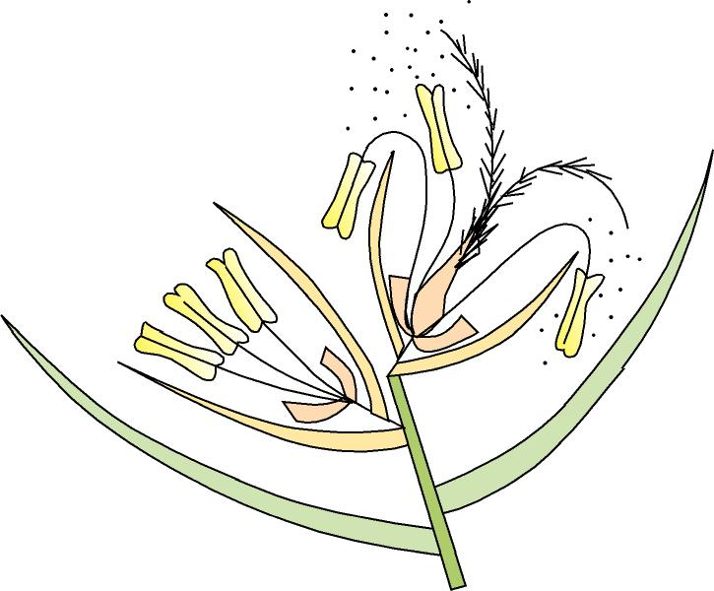
Pollination in a Wind-pollinated Flower (Ischaemum muticum)
pollen grains
upper bisexual flower
anther
lower male flower
feathery stigmas hanging out of the bracts
filament
lodicule
non-flowering bract (scale)
flowering bract (scale)
When the filaments sway in the wind, the dust-like pollen is shaken free and carried away by the wind.
Copyright © 2006-2011 Marshall Cavendish International (Singapore) Pte. Ltd.
January 16, 10
27
Notes:
Figure 16.16 Page 306

Slide 28
Pollination in a Wind-pollinated Flower (Ischaemum muticum)
upper bisexual flower
anther
lower male flower
feathery stigmas hanging out of the bracts
filament
lodicule
non-flowering bract (scale)
flowering bract (scale)
The mature stigmas do not hang freely but project out of the bracts. They are large, extended and feathery.
Copyright © 2006-2011 Marshall Cavendish International (Singapore) Pte. Ltd.
January 16, 10
28
Notes:
Figure 16.16 Page 306

Slide 29
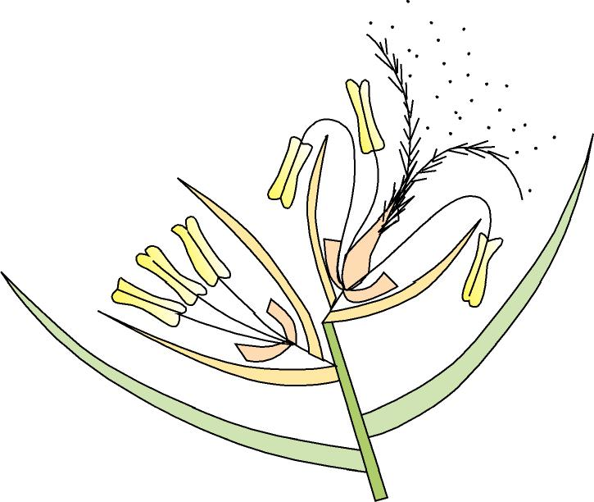
Pollination in a Wind-pollinated Flower (Ischaemum muticum)
pollen grains
upper bisexual flower
anther
lower male flower
feathery stigmas hanging out of the bracts
filament
lodicule
non-flowering bract (scale)
flowering bract (scale)
The mature stigmas do not hang freely but project out of the bracts. They are large, extended and feathery.
Thus, they provide a large surface area to receive any pollen that is floating around in the wind.
Copyright © 2006-2011 Marshall Cavendish International (Singapore) Pte. Ltd.
January 16, 10
29
Notes:
Figure 16.16 Page 306

Slide 30
Refer to Table 16.1 on Characteristics of insect-pollinated and wind-pollinated flowers

Slide 31
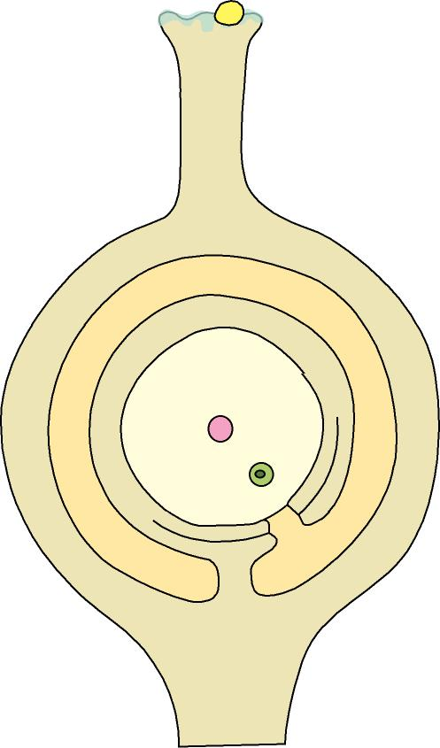
Fertilisation
pollen grain
sugary fluid
stigma
1
After pollination, the pollen grains germinate in response to the sugary fluid secreted by the mature stigma.
Copyright © 2006-2011 Marshall Cavendish International (Singapore) Pte. Ltd.
January 16, 10
31
Notes:
Figure 16.22 Page 309

Slide 32
Fertilisation
germinating pollen grain
stigma
pollen tube
2
A pollen tube grows out from each pollen grain.
Copyright © 2006-2011 Marshall Cavendish International (Singapore) Pte. Ltd.
January 16, 10
32
Notes:
Figure 16.22 Page 309

Slide 33
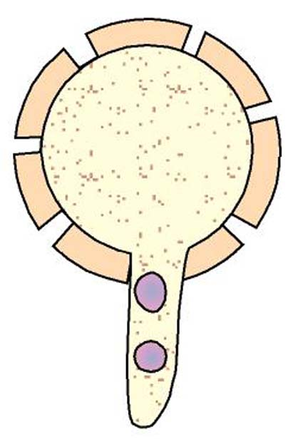
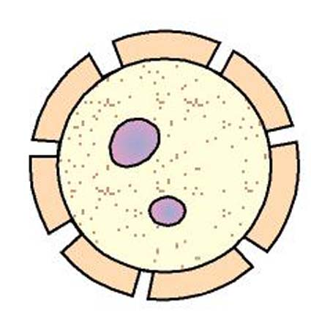
Fertilisation
Pollen grain germinates
Mature pollen grain
pollen tube nucleus
cytoplasm
generative nucleus
generative nucleus
pollen tube nucleus
cytoplasm
pollen tube
The cytoplasm and the two nuclei (pollen tube nucleus and generative nucleus) of each pollen grain pass into the pollen tube.
The growth of the pollen tube is controlled by the pollen tube nucleus.
3
Copyright © 2006-2011 Marshall Cavendish International (Singapore) Pte. Ltd.
January 16, 10
33
Notes:
Figure 16.22 Page 309

Slide 34
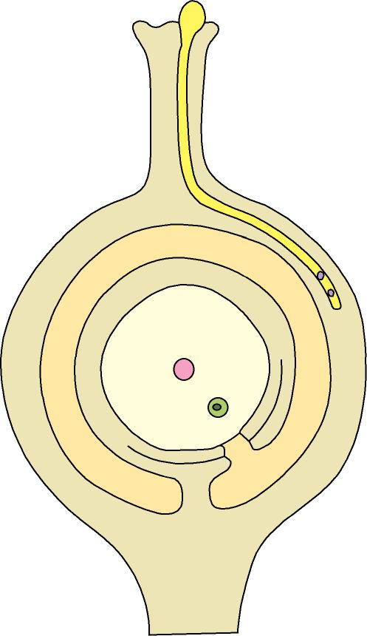
Fertilisation
germinating pollen grain
style
stigma
pollen tube
As the pollen tube grows, it secretes enzymes to digest the surrounding tissue of the stigma and style.
Thus, the pollen tube penetrates right through the style as it grows.
4
Copyright © 2006-2011 Marshall Cavendish International (Singapore) Pte. Ltd.
January 16, 10
34
Notes:
Figure 16.22 Page 309

Slide 35
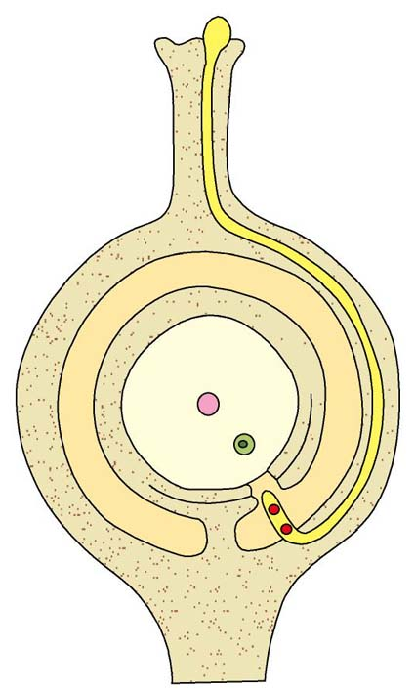
Fertilisation
germinating pollen grain
style
stigma
pollen tube
micropyle
5
The pollen tube enters the ovule usually through an opening in the ovule wall called the micropyle.
Copyright © 2006-2011 Marshall Cavendish International (Singapore) Pte. Ltd.
January 16, 10
35
Notes:
Figure 16.22 Page 309

Slide 36
Fertilisation
germinating pollen grain
style
stigma
pollen tube
micropyle
male gametes
6
Along the way, the generative nucleus divides to form two male gametes.
The pollen tube nucleus soon disintegrates.
Copyright © 2006-2011 Marshall Cavendish International (Singapore) Pte. Ltd.
January 16, 10
36
Notes:
Figure 16.22 Page 309

Slide 37
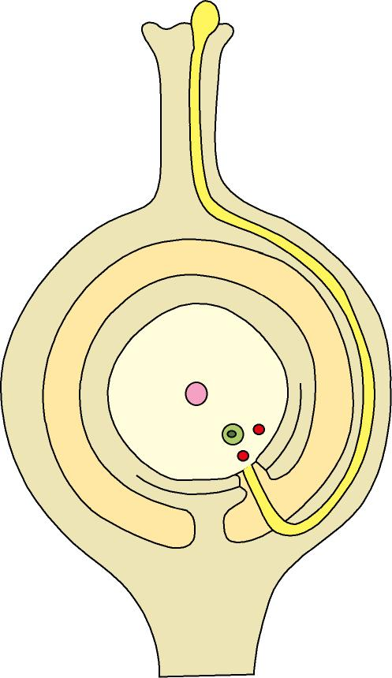
Fertilisation
germinating pollen grain
style
stigma
pollen tube
ovary wall
ovule
male gametes
micropyle
funicle
placenta
7
Within the ovule, the tip of the pollen tube absorbs sap and bursts, releasing the two male gametes.
Copyright © 2006-2011 Marshall Cavendish International (Singapore) Pte. Ltd.
January 16, 10
37
Notes:
Figure 16.22 Page 309

Slide 38
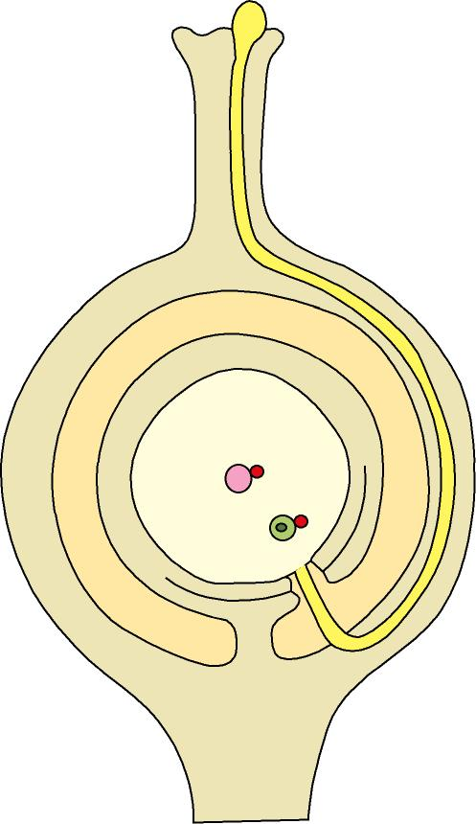
Fertilisation
germinating pollen grain
style
stigma
pollen tube
ovary wall
definitive nucleus
ovule
male gametes
ovum (egg)
micropyle
funicle
placenta
8
One male gamete fuses with the ovum to form the zygote. This is fertilisation.
The other male gamete fuses with the definitive nucleus to form the endosperm nucleus.
Copyright © 2006-2011 Marshall Cavendish International (Singapore) Pte. Ltd.
January 16, 10
38
Notes:
Figure 16.22 Page 309

Slide 39
Fertilisation
germinating pollen grain
style
stigma
pollen tube
ovary wall
definitive nucleus
ovule
male gametes
ovum (egg)
micropyle
funicle
placenta
9
The zygote will divide and develop into the embryo in the seed.
The endosperm nucleus will divide and give rise to the food storage tissue called the endosperm.
Copyright © 2006-2011 Marshall Cavendish International (Singapore) Pte. Ltd.
January 16, 10
39
Notes:
Figure 16.22 Page 309

Slide 40
4.1B
2, 3, 4, 5, 7, 8, 9
Paper 2
1, 2c(i), (ii)

Slide 41
MCQ
2 C
3 A
4 D
5 D
7 C
8 D
9 A

Slide 42
1
P –anther
Q – filament
R – pollen grain

Slide 43
(b)(i)
Chromosome number is halved as cells divide

Slide 44
b(ii)
When the male and female gametes fuse together to form a zygote, the chromosome number is restored. If not, the chromosome number is doubled each time an organism reproduced

Slide 45
(c)
Stamen produces pollen grains for sexual reproduction. Hence, nutrients such as glucose and amino acids need to be transported to the stamen for production of the pollen grains via the phloem (structure W)

Slide 46
2c
Leaves
Sugar are translocated to the fruit via the phloem

